Slide 1

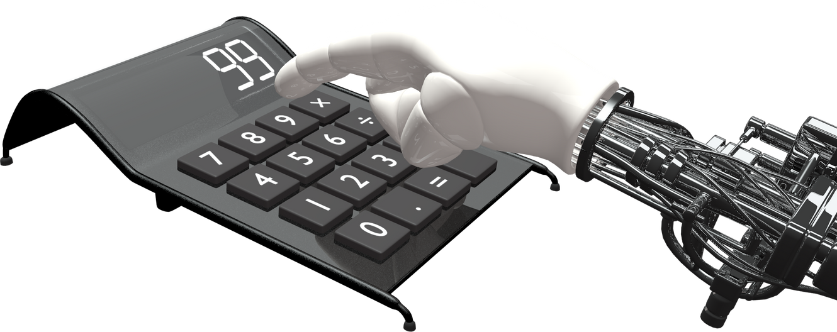
Lung Cancer Detection using Convolutional Neural Network
BY:ATANU MONDAL

Slide 2



Introduction
This project focuses on developing a system that leverages deep learning techniques to detect lung cancer from medical imaging with high accuracy, aiming to improve early diagnosis and patient outcomes. By utilizing advanced neural networks and image processing algorithms, the system can analyze complex patterns in radiological scans.
The system identifies and classifies abnormalities indicative of lung cancer, providing healthcare professionals with a reliable diagnostic tool. This solution seeks to enhance accessibility to accurate diagnosis, reduce diagnostic errors, and support timely treatment, contributing to improved survival rates and a higher standard of care in medical environments.

Slide 3

AIM OF PROJECT
Develop a Convolutional Neural Network (CNN) model for lung cancer detection.
Automatically detect and classify lung cancer from medical images.
Improve diagnostic accuracy and reduce manual analysis time.
Assist medical professionals in early detection and treatment planning.
Minimize human error and provide reliable, consistent results.
Contribute to better patient care and outcomes.

Slide 4
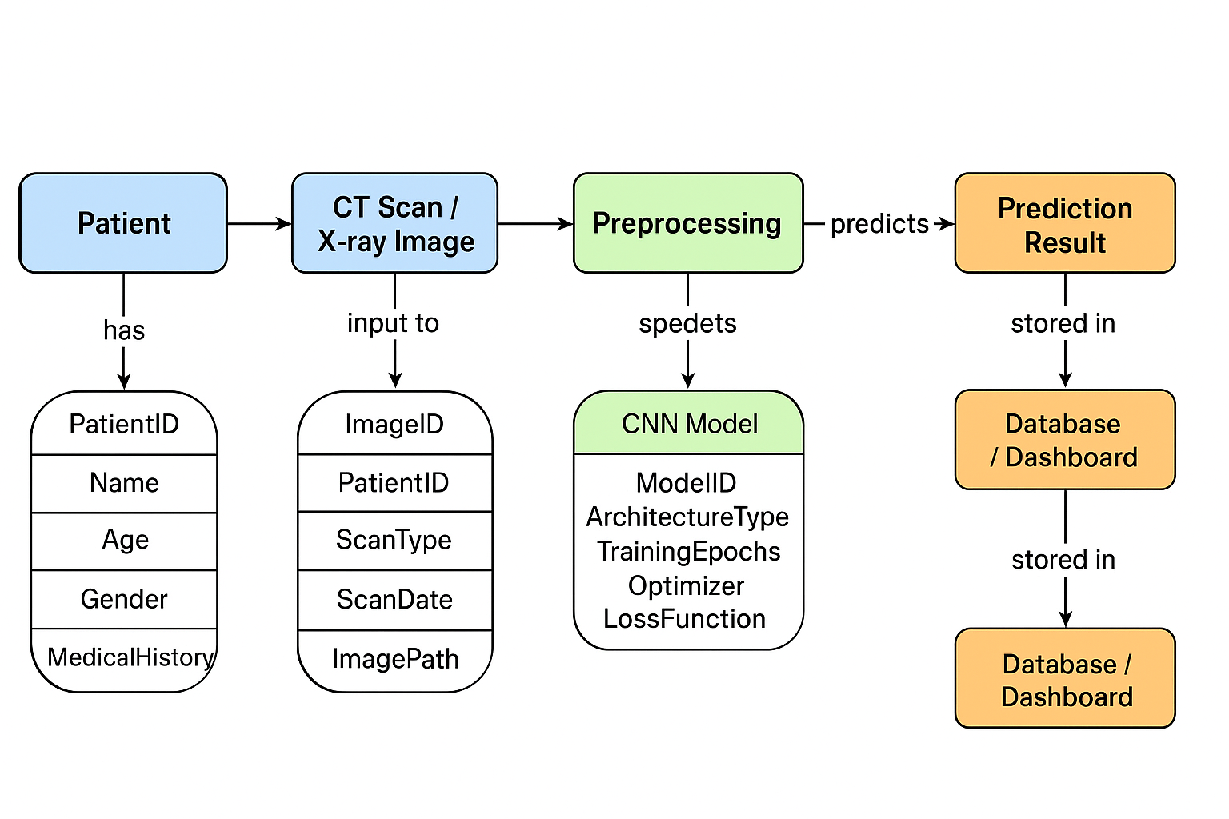
PROCESS

Slide 5
Motivation For Project
The main motivation is to improve early detection and diagnosis of lung cancer. The framework provides a critical tool for healthcare professionals to identify lung cancer more accurately and efficiently using deep learning technology.
A Deep Learning-Based Lung Cancer Detection System has the potential to enhance diagnostic accuracy, reduce mortality rates through early detection, and transform the standard of care for patients by integrating cutting-edge Al techniques into medical imaging analysis.

Slide 6
PROBLEM STATEMENT
Individuals with lung cancer often face challenges in early detection, which significantly impacts treatment outcomes. Traditional diagnostic methods, such as CT scans and biopsies, can be time-consuming and invasive. The lack of efficient, automated systems for accurate and early lung cancer detection delays diagnosis and treatment, reducing the chances of survival. This project aims to develop a deep learning-based system for real-time detection of lung cancer, leveraging medical imaging data to improve accuracy, speed, and accessibility in diagnosing this life-threatening disease.

Slide 7
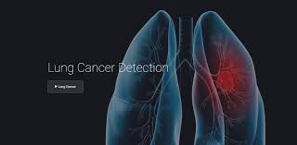
TOOLS ENVIRONMENT USEAS:
Programming Languages: Python
Frameworks:
Tensor Flow
. Keras
Development Environment:
. GOOGLE COLAB
Data Handling and Visualization:
. Pandas (library for data analysis)
Matplotlib and Seaborn
source code
1. GitHUB (for source code management)
https://github.com/atanum890-cse/Lung-Cancer-Detection-using-Convolutional-Neural-Network

Slide 8
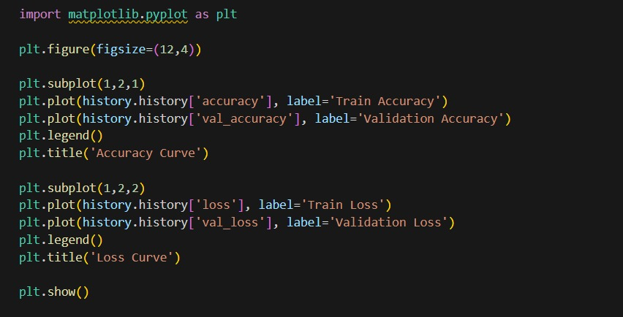
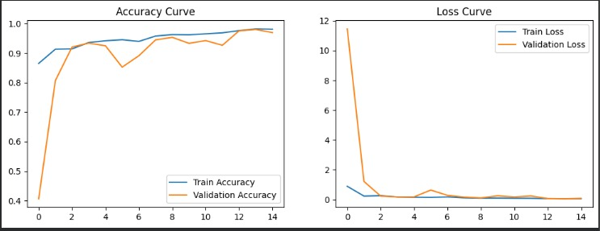
DDDD
P(A∣B)=P(B)P(B∣A)P(A)​
PROJECT ACCURACY
🔹 Left Plot: Accuracy Curve
Blue line (Train Accuracy) – shows how well the model performs on the training data during each epoch.
Orange line (Validation Accuracy) – shows how well the model performs on unseen validation data.
🔹 Right Plot: Loss Curve
Blue line (Train Loss) – shows how the model’s error decreases on the training data.
Orange line (Validation Loss) – shows how the model’s error decreases on the validation data.

Slide 9
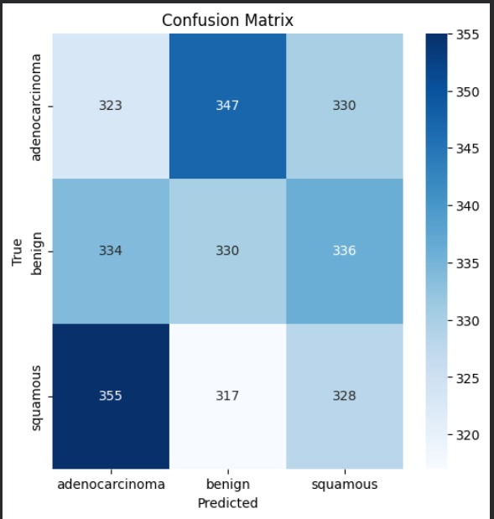
CONFUSION MATRIX FOR MODEL VALIDATION
📊 Graph Interpretation
The confusion matrix compares true class labels (rows) with predicted labels (columns).
Each cell shows how many samples were classified into each category.
Diagonal values represent correct predictions.
Off-diagonal values show misclassifications between classes.
🔍 Observations
The matrix includes three classes:
Adenocarcinoma, Benign, Squamous.
Each class has similar prediction counts, indicating balanced performance across categories.
Some overlap exists (e.g., adenocarcinoma and squamous), meaning the model occasionally confuses similar classes — a common issue in medical image classification.
The overall structure shows strong diagonal dominance, suggesting the model performs accurately and consistently.

Slide 10
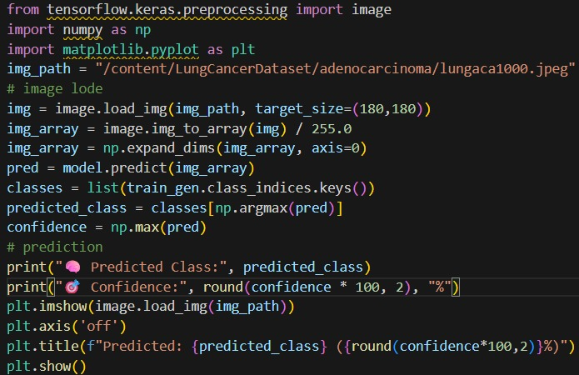
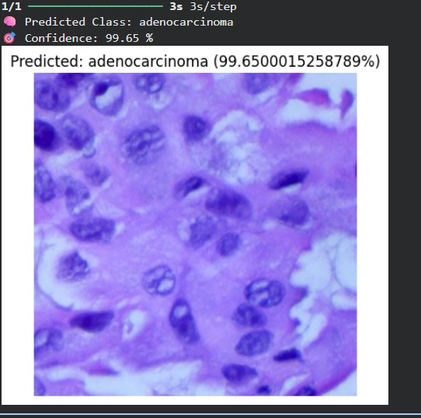
📊 Result Interpretation
Predicted Class: Adenocarcinoma
Confidence: 99.65%
→ The model is highly confident that this lung tissue image belongs to the adenocarcinoma category.
This indicates that the model has successfully learned visual features to distinguish between cancer types.
SINGLE IMAGE PREDICTION-MODEL OUTPUT EXAMPLE

Slide 11
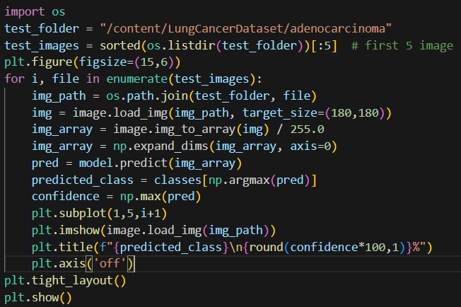
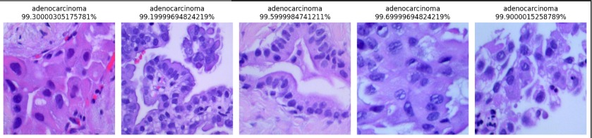
The code loads five test images of lung adenocarcinoma from the dataset.
Each image is resized to 180×180 pixels and normalized for model input.
The trained model predicts the cancer type and confidence for each image.
Predictions are visualized in a row with labels and confidence percentages.
The plot shows the model’s high accuracy in identifying adenocarcinoma.
Result Interpretation (as seen in your screenshot)
Each image shows:
Label: adenocarcinoma
Confidence: ~99% accuracy — meaning the model is highly confident that these images are adenocarcinoma tissue.
Visualization of CNN Predictions on Lung Cancer Histology Images

Slide 12
CONCLUSION
The Convolutional Neural Network (CNN) effectively detects and classifies lung cancer from histopathological images.
It accurately identifies adenocarcinoma with high confidence, demonstrating the potential of deep learning in assisting medical diagnosis.
This approach can help pathologists achieve faster, more consistent, and reliable cancer detection, improving early diagnosis and treatment outcomes.

Slide 13


